Slide 1
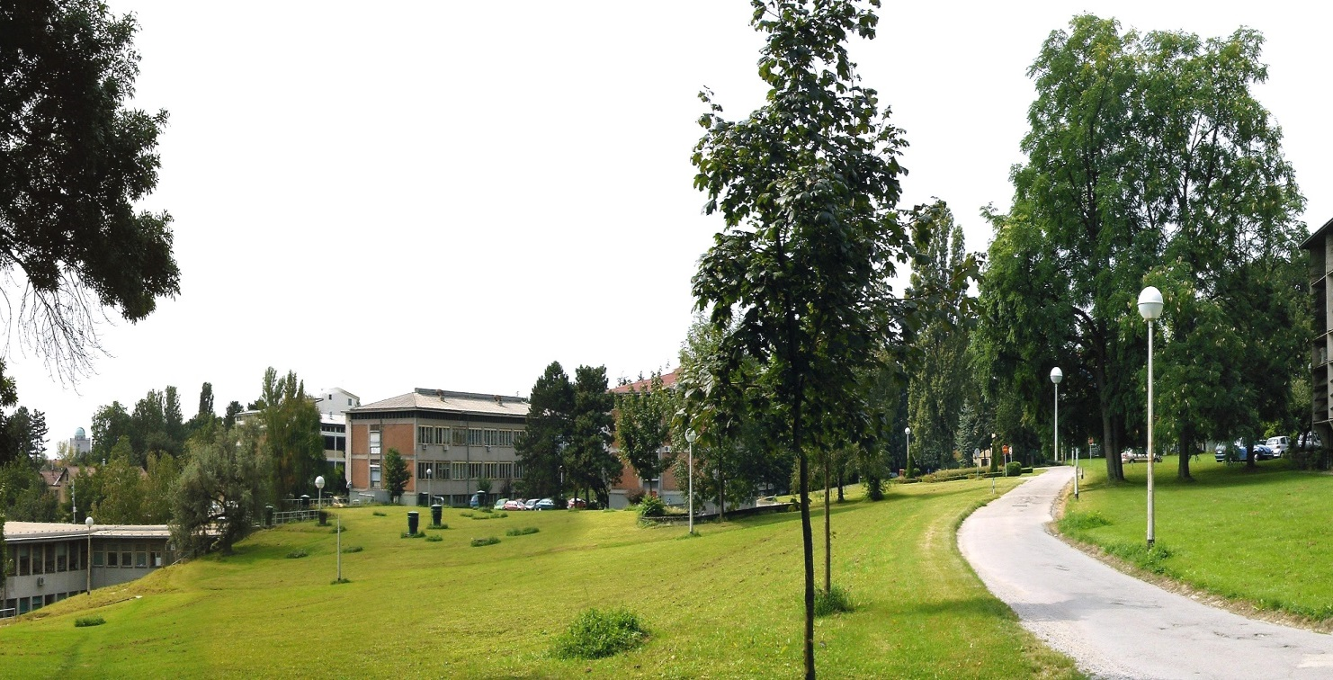

O-ZIP STRUCTURAL PROJECT
Open scientific infrastructural platforms for innovative applications in the economy and society
Major infrastructure project foreseen for funding from the
European Regional Development Fund (ERDF)

Slide 2
R&D sector in Croatia
Majority of all scientists are employed in public sector which presents key research infrastructure available within the country.
Good scientific potential and represent solid scientific base for development of competitive, innovation-driven economy
Primary obstacles restricting the capacity of the research community to undertake excellent research, conduct economy-driven research and to transfer results to the wider economy are related to outdated and scattered R&D equipment and underdeveloped infrastructure
These obstacles do not permit research to be carried out according to international standards, thus hindering the quality of research outputs, results and impacts, making Croatia less competitive compared to the EU average
Problems of Croatian R&D and economy will be tackled with targeted investments in priority areas defined by the Smart specialization strategy (S3).

Slide 3
Smart Specialisation Strategy

Slide 4

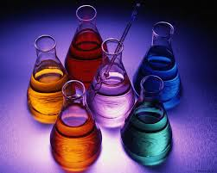
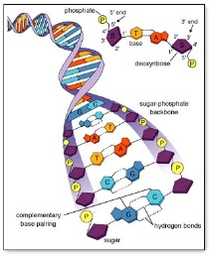


RBI - LARGEST CROATIAN MULTIDISCIPLINARY RESEARCH INSTITUTE (850 employees, 450 Ph.D.s)
5 % of Croatian researchers
~ 50 % of Croatian Horizon 2020
15 % of Croatian publications
30 % of top 25 % publications
PHYSICS
CHEMISTRY
LIFE SCIENCES
ENVIRONMENT
COMPUTER SCIENCE
THEORETICAL PHYSICS | MATERIAL CHEMISTRY | MOLECULAR MEDICINE | SEA & ENVIROMENT | ELECTRONICS
MATERIAL PHYSICS | ORGANIC CHEM. & BIOCHEMISTRY | MOLECULAR BIOLOGY | CENTER FOR SEA RESEARCH | INFORMATICS AND COMPUTING
EXPERIMENTAL PHYSICS | PHYSICAL CHEM.
 | NMR
Excellent science
Strong involvement in higher education
Leading contribution to the growth of the national economy
Notes:
Izvor IRB Ured za projekte i međunarodnu suradnju

Slide 5

S3 thematic areas
KET
Health and Energy and Sustainable Transport and mobility Security Agro-food and
quality of life Environment bio-economy
BioMed
MarEnv
TechMat
ICST
RBI research areas
Plant-based production systems Precision medicine Functional materials Natural products Photonics
Big Data Technologies Environmental forensics Metagenomics & Biodiversity mapping Detectors,
Analytics sensor and devices
Environmental management and susteinability Scinetific Intelligent Systems, Workflows Environmental impact and and Algorithms risk assessment

Slide 6
Four multidisciplinary research platforms will be established, operating on open access principles, focused on research, application and transfer of knowledge and technologies in different priority areas defined by S3.
Biological and Medical Research Infrastructural Platform (BioMed) is focused on development of innovative medical and biotechnology solutions, aimed to solve practical challenges in medicine, pharmacy, food production, agriculture, and ecology.
Advanced Technologies and Materials Research Infrastructural Platform (TechMat) is dedicated to synthesis and production of materials, development of advanced analytical techniques for characterisation of materials, photonics and new devices, and radiation technology.
Marine and Environmental Research Infrastructural Platform (MarEnv) addresses complex environmental problems through research activities on marine and freshwater systems, as well as sustainable management and protection of environmental resources.
Information and Communication Sciences and Technology Infrastructural Platform (ICST) is concentrated on development of e-Science through research activities based on utilisation of data, software and e-Infrastructure, with applications in different areas, therefore unifying all priority areas within OZIP.

Slide 7
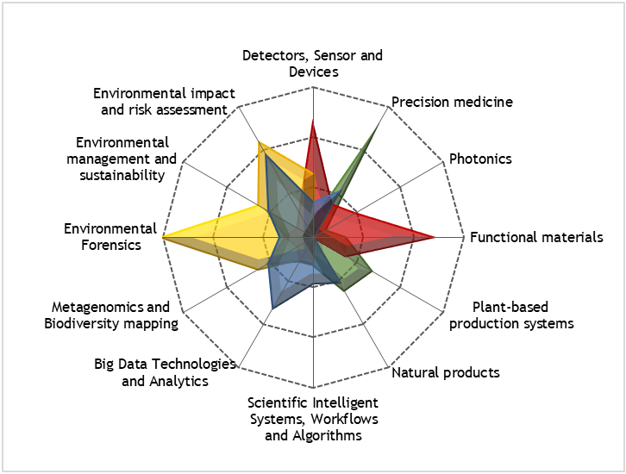
Interdisciplinary nature of O-ZIP platforms in terms of priority research areas

Slide 8

BioMed Platform
Biological and Medical Research Infrastructural Platform
Advanced Diagnostics Unit
Chemical and Biochemical Unit
Biotechnology
Unit
Bioimaging
Unit
Animal Model Centre
Research topics:
Precision medicine
Functional materials
Plant-based production systems
Natural products
Horizon 2020 challenge: Health, demographic change and wellbeing
The Innovative Medicines Initiative (IMI):
Develop medicines and therapies that can cure currently untreatable diseases
Health and Agro-food and quality of life bio-economy
Pharmaceutical industry
Chemical Industry
Food processing industry

Slide 9
MarEnv Platform
Marine and Environmental Research Infrastructural Platform
Oceanography and Environmental Modeling Unit
Biogeochemistry and Analytics Unit
Biochemistry and Biodiversity
Unit
Radioecology
Unit
Research Station Martinska
Research topics:
Metagenomics and Biodiversity mapping Environmental Forensics
Environmental management and sustainability
Environmental impact and risk assessment
Horizon 2020 Societal Challenge: Climate action, environment, resource efficiency & raw materials
Energy and
Sustainable Environment
Agro-food and
bio-economy
Sustainable supply of food, energy, biomaterials
Environmental and human health
Sustainable aquaculture management

Slide 10
ICST Platform
Information and Communication Science and Technology Platform
Network and Communication Support Unit
Data Analytics Unit
Advanced HPC Unit
Scientific Information Systems and Cloud Services Unit
Research topics:
Scientific Intelligent Systems, Workflows and Algorithms
Big Data Technologies and Analytics
KETs are a priority for European industrial policy
KET
Health and Agro-food and
quality of life bio-economy
Pharmaceutical industry
Food processing industry
Creative industries

Slide 11
TechMat Platform
Advanced Technologies and Materials Research Infrastructural Platform
Synthesis and Production of Materials
Characterization Unit
Photonics Unit
Radiation Technology Unit
Research topics:
Functional materials
Photonics
Detectors, sensors and devices
KETs are a priority for European industrial policy
KET
Transport and mobility Security
Electrical and mechanical machines and equipment production
Wood-processing industry
Defence industry
Pharmaceuticals and medical equipment production
Food processing industry

Slide 12

Main goals and activities
The main goal of O-ZIP is upgrading and unzipping of the RBI intellectual property, capital equipment and know-how, while increasing the RBI impact in the ERA and boosting cooperation between scientific, academic and business sector.
Construction
Equipment

Slide 13
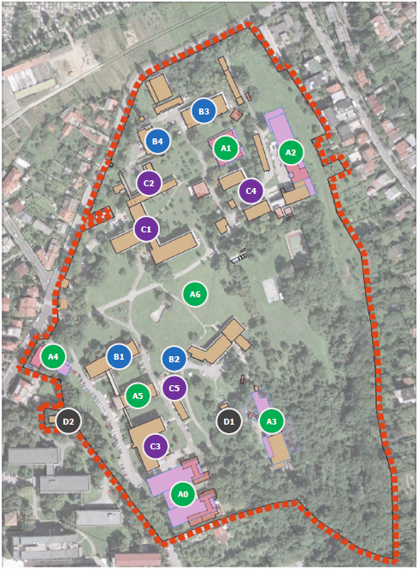

Slide 14
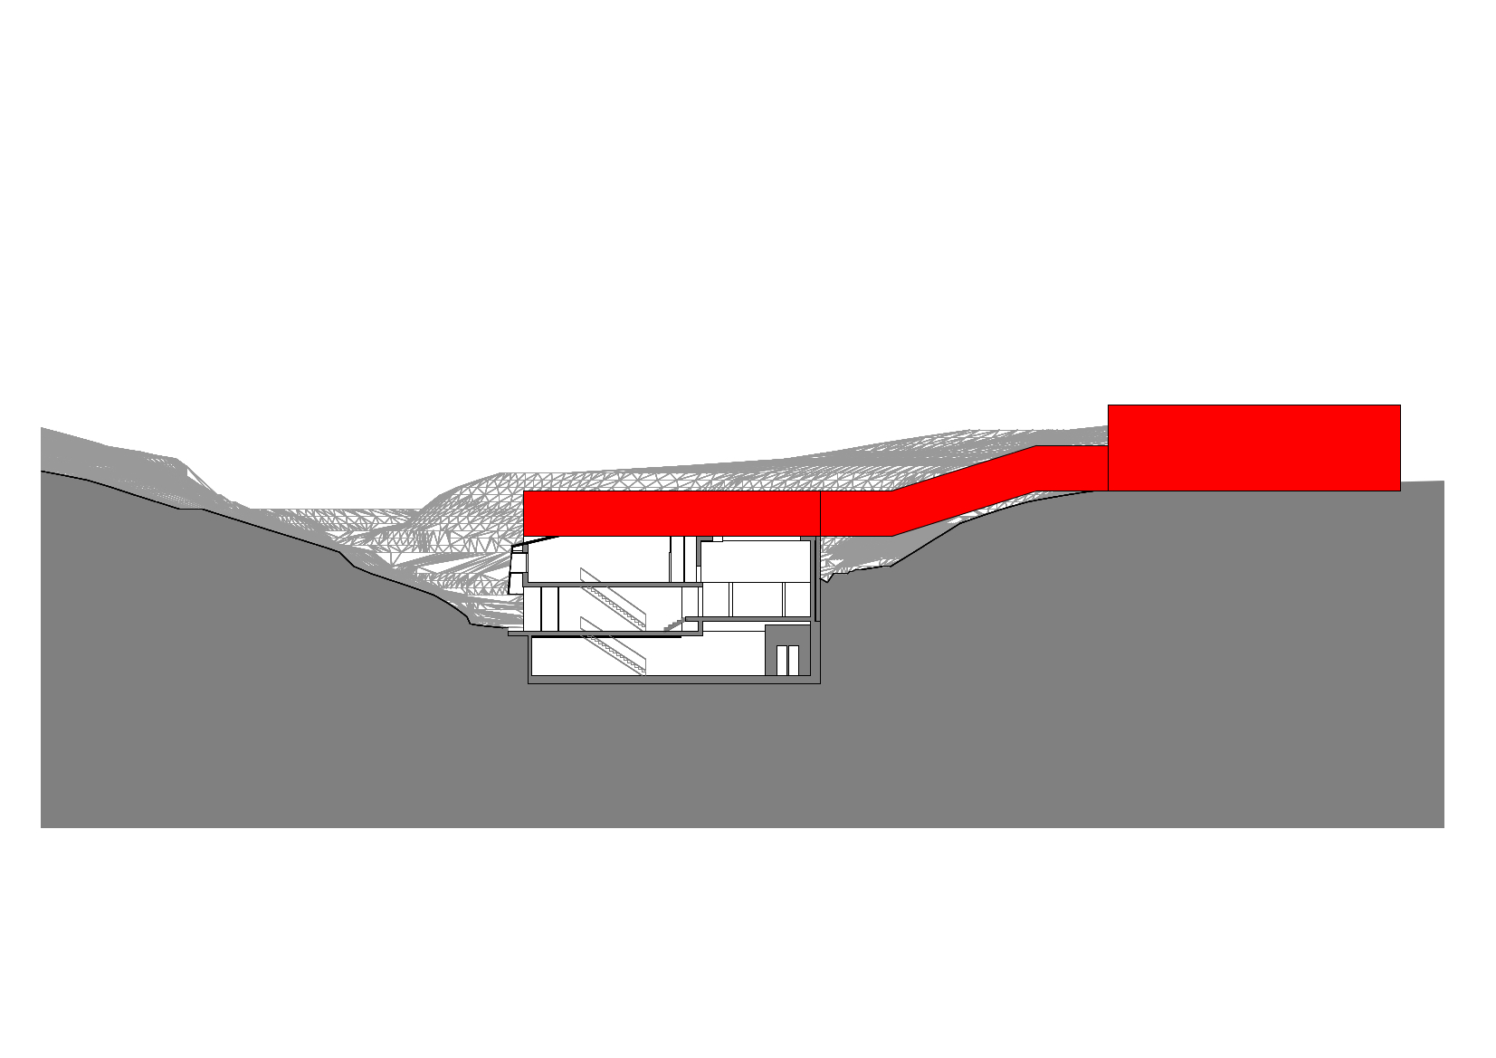

Slide 15
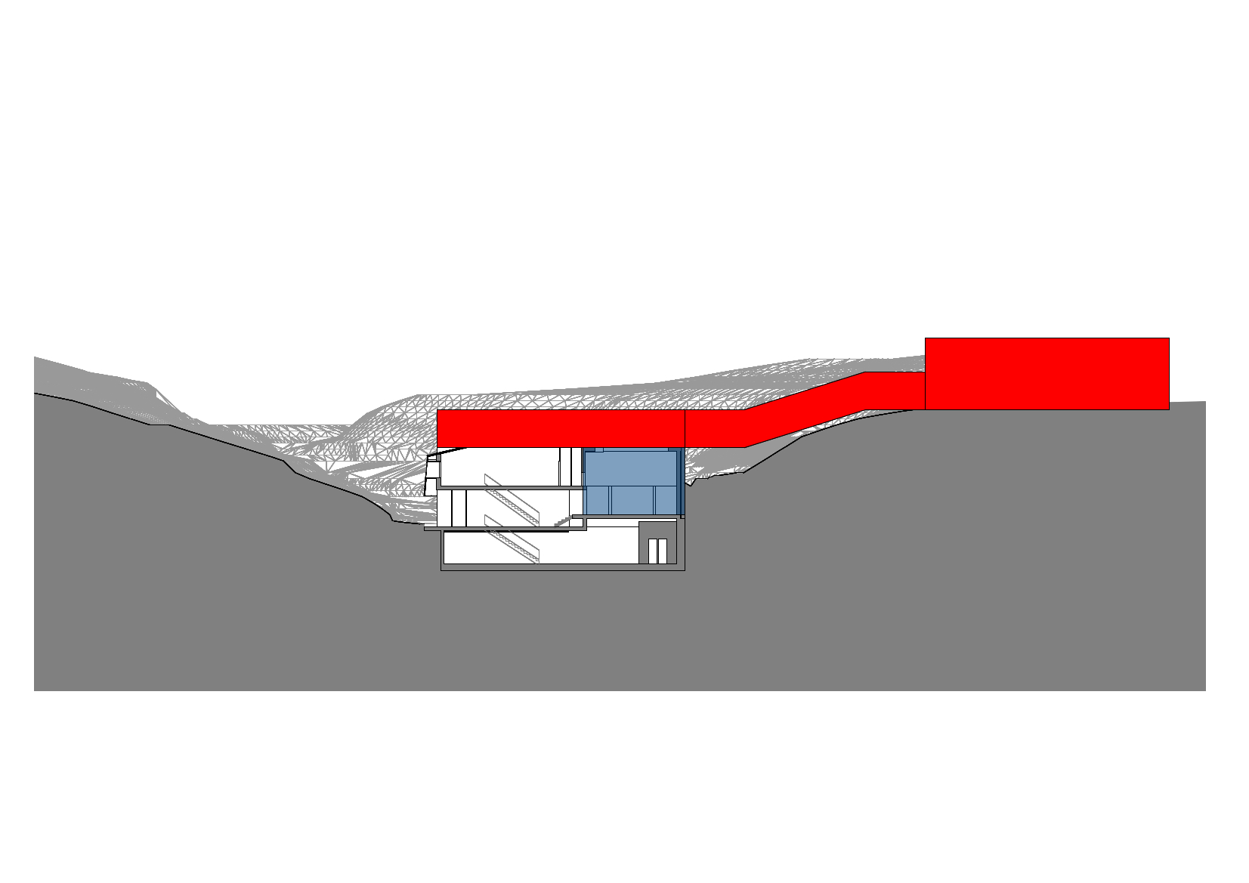

Slide 16
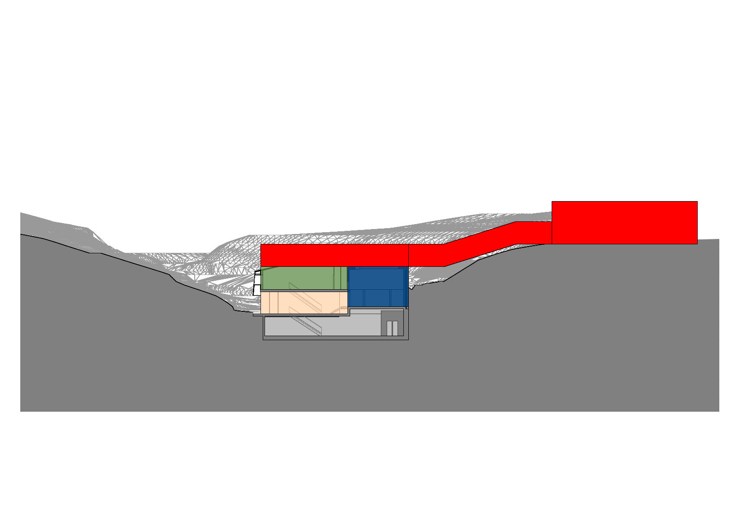

Slide 18
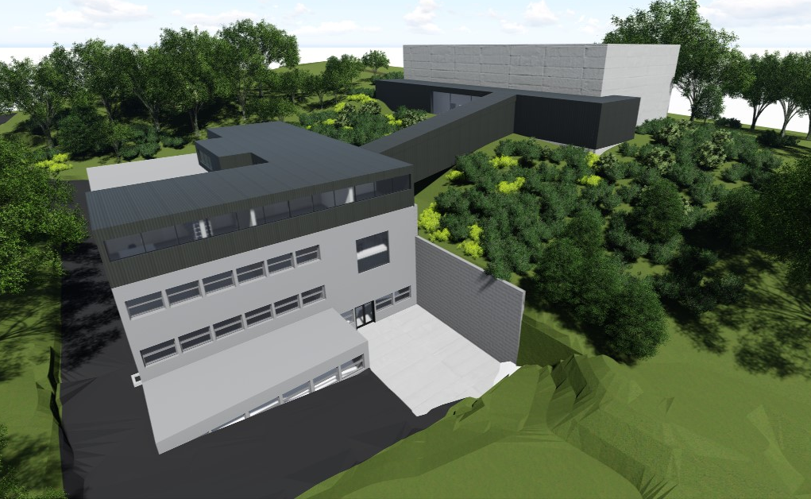
A3 | NAL

Slide 19
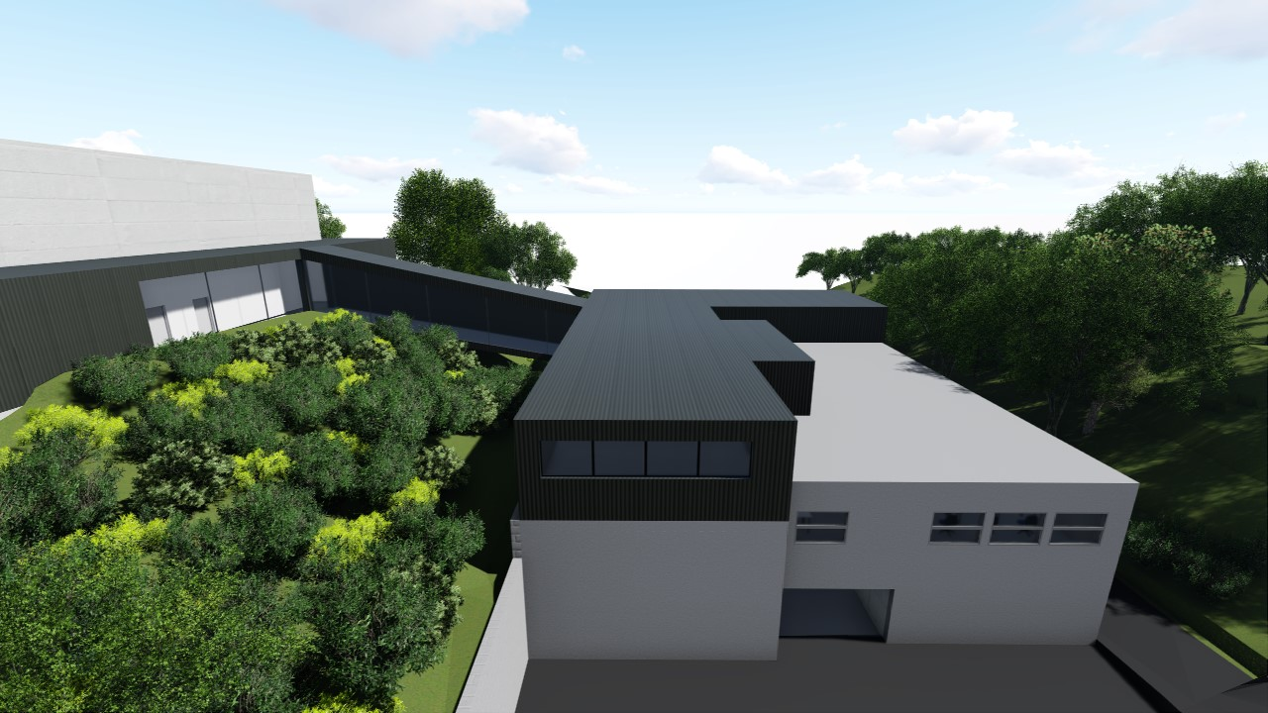

Slide 20
TECHMAT Costs– capital equipment
Equipment | Cost / EUR
Thin film deposition cluster based on sputtering and atomic layer deposition techniques | 400.000
X-ray diffraction equipment (PXRD) | 352.000
TEM, sample preparation for TEM and routine SEM | 1.200.000
Spectroscopy techniques (Raman/AFM) | 320.000
Thermal analysis techniques (HT-DSC/HT-TGA, HP-DCS¸, TG-FTIR) | 240.000
Preparation cluster (materials cleaning, etching, bonding, metallization, etc.) | 152.000
Optoelectronic characterization techniques (electro photoluminescence, semiconductor parameter characterization, helium cryostat, etc.) | 240.000
Photonics and quantum optics laboratory (lasers, optical tables, ultrafast electronics for signal generation and data acquisition etc.) | 80.000
Photonics test and measurement system for characterization of optical elements | 80.000
5.0 MV tandem accelerator | 2.000.000
High radiation chamber for nuclear reactions | 200.000
Detector development cluster | 200.000
AMS carbon dating sample preparation laboratory | 80.000

Slide 21
OZIP status
June 2012: project submmition
December 2012: shortlisted for the ERDF
December 2013: financial assistance for the preparation of project documentation through the STP II
June 2014: O-ZIP in OP 2014-2020
April 2016: Preparation of FS, with CBA and the Technical Documentation Report as an integral part of the FS.
JASPERS assistence for major projects
November 2018: deadline for FS and CBA
December 2018: Independent quality review
2019: Start...
JASPERS: Joint Assistance to Support Projects in European Regions

